Slide 1
Publicis Sapient

Slide 2
Online Cash Deposit Form in Banks
Server Based Application

Slide 3

Agenda
1
Problem Statement
2
Objective
3
Implementation
4
Microservices
5
MongoDB & Result
Publicis
Sapient

Slide 4

Objective
Extend a console-based Java application to interact with a Node.js server deployed on a Linux environment using microservices. The system will manage online cash deposit forms for banks. The solution will ensure efficient data storage, retrieval, and scalability.
Publicis
Sapient

Slide 5
Problem Statement
The microservices will manage and store the following data:
Branch Name Date (calendar), Name, Account Number, Amount (in numbers), Amount (in words), Denominations for each note (e.g., 500, 100, 200), Total Amount, Mobile Number, PAN Number, Email ID
Publicis
Sapient

Slide 6
MICROSERVICES
Microservices is an architectural style where a software application is composed of small, independent services that communicate over a network.
Microservices are a way to build software as a collection of small, separate services, each doing one specific job. Each service runs on its own and communicates with others to work together.
Publicis
Sapient

Slide 7
MicroServices
i) Handlers
Functions that process incoming requests and generate responses, like validating data, retrieving data.
ii) Controllers
It handles the business logic by processing requests and determine which service to call.
iii) Responses
Messages sent from the server back to the client after processing a request, in form of JSON.
iv) Routers
Routes incoming requests to the appropriate handlers based on the URL and HTTP method.
v) Requests
Messages sent from the client to the server asking for data or action.
GET Requests:
Used to fetch resources (HTML, CSS, JavaScript files) from the server.
POST Requests:
Used to submit data to the server, in this case, deposit information.
Publicis
Sapient

Slide 8
Implementation

Slide 9
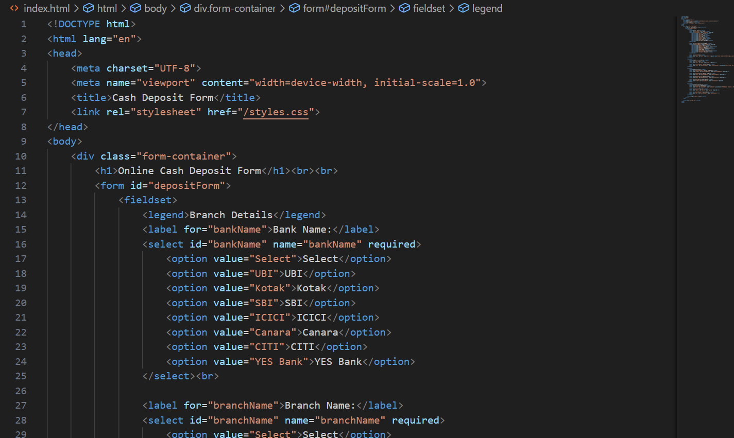
HTML

Slide 10
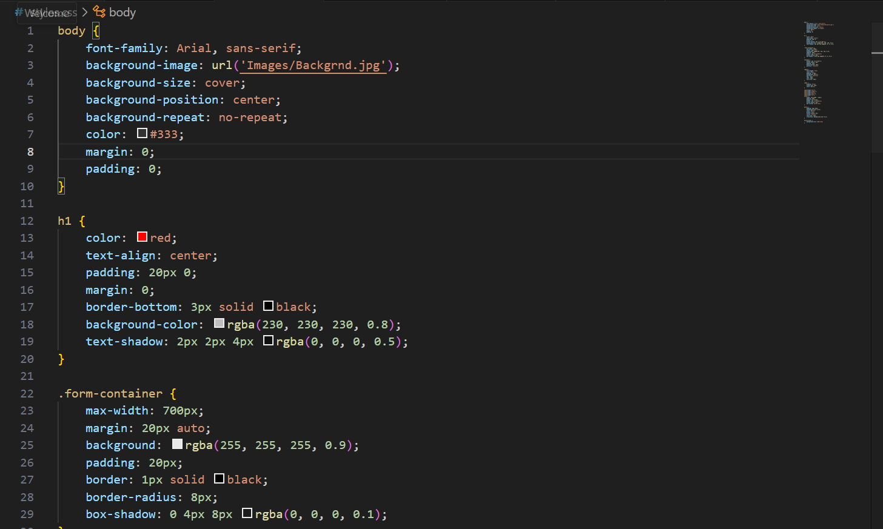
CSS

Slide 11
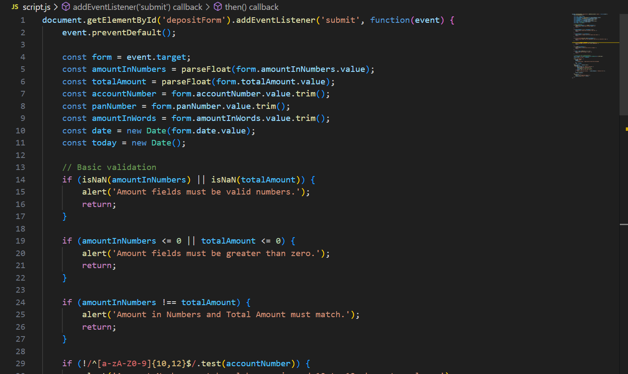
Validation

Slide 12
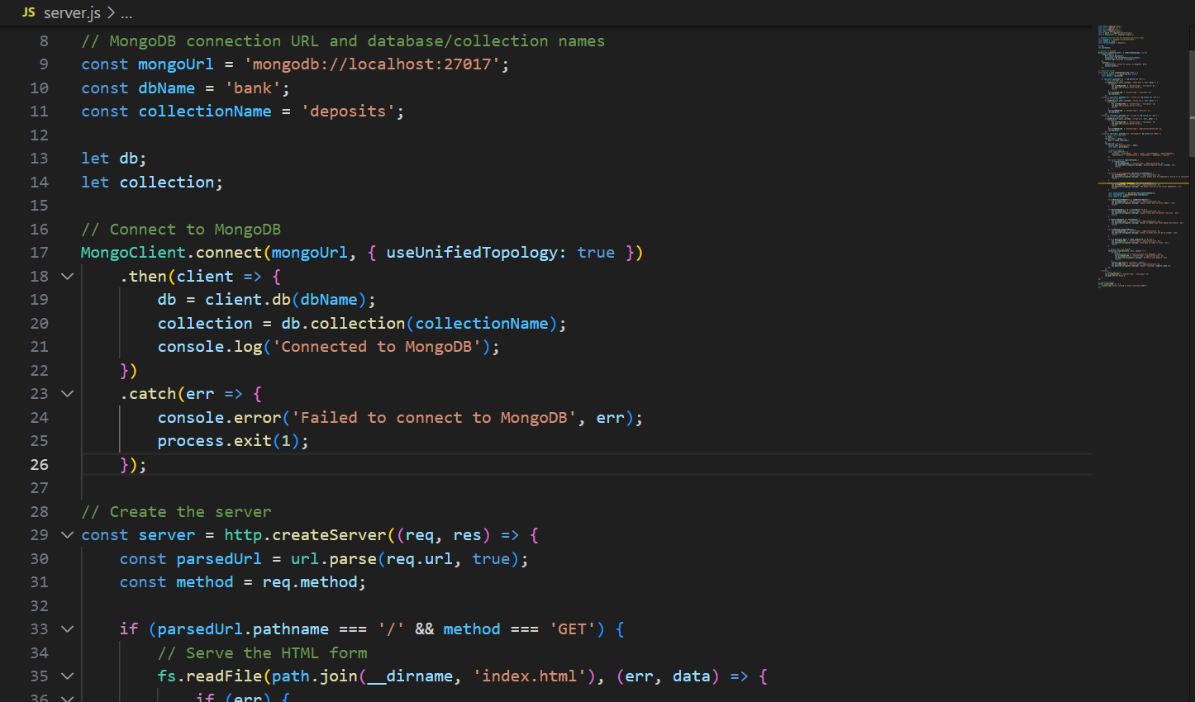
Server

Slide 13
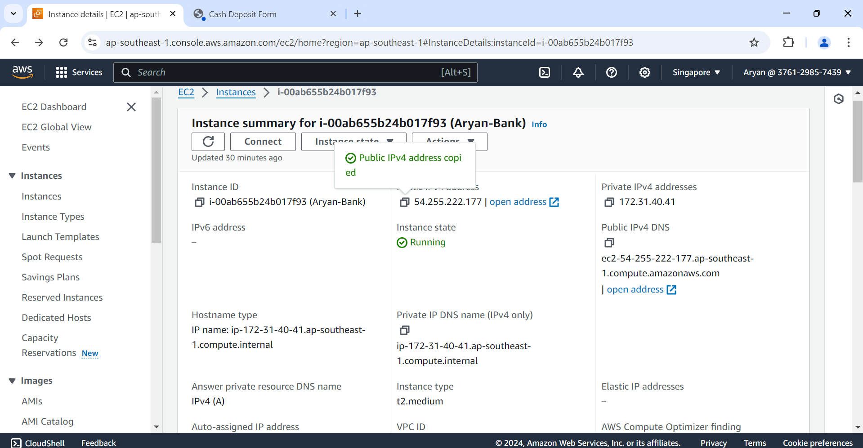

Slide 14
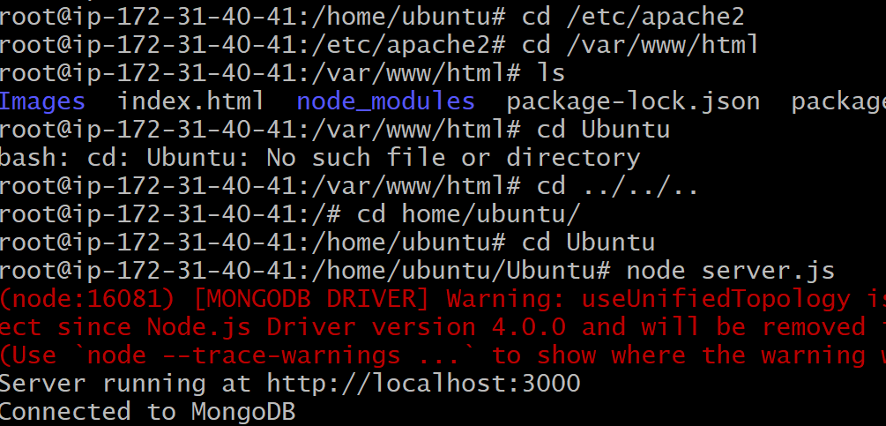
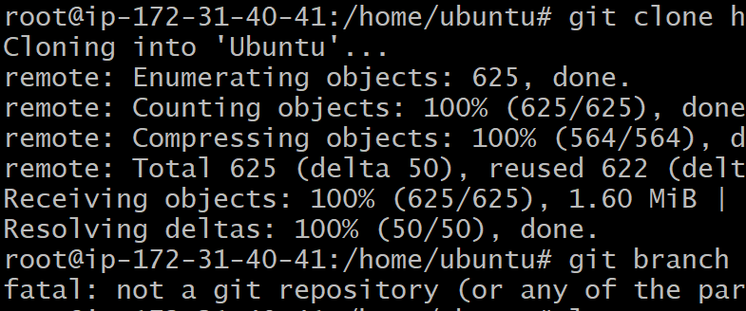
Linux Ubuntu Server

Slide 15
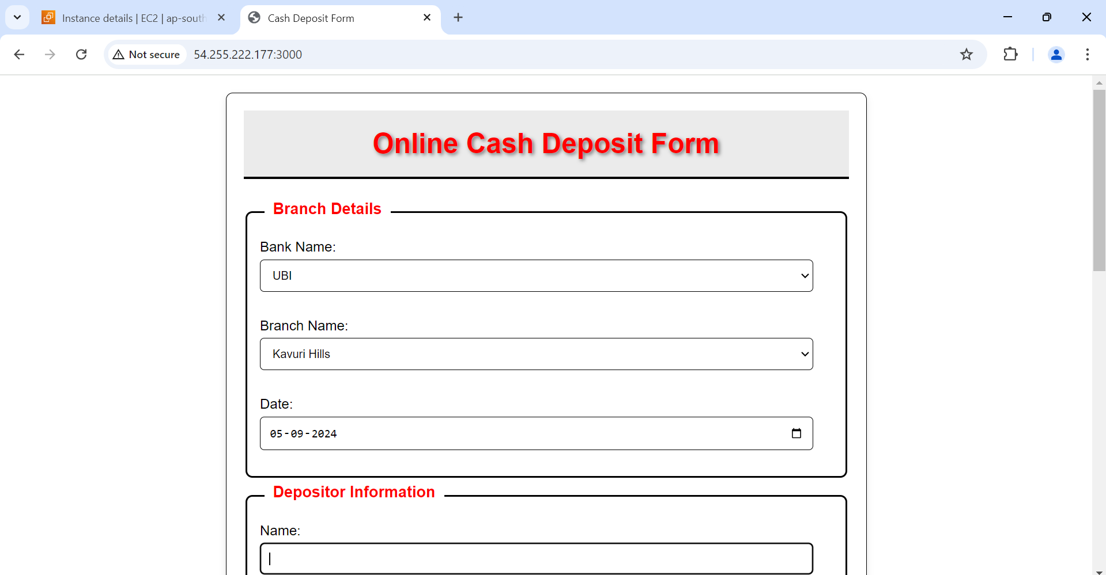
Publicis
Sapient

Slide 16
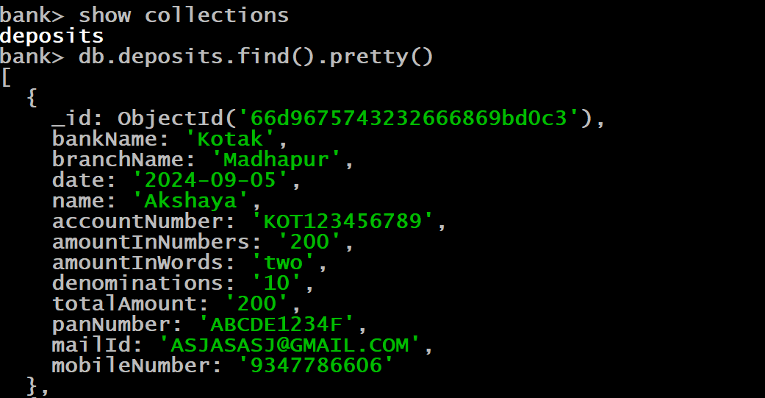
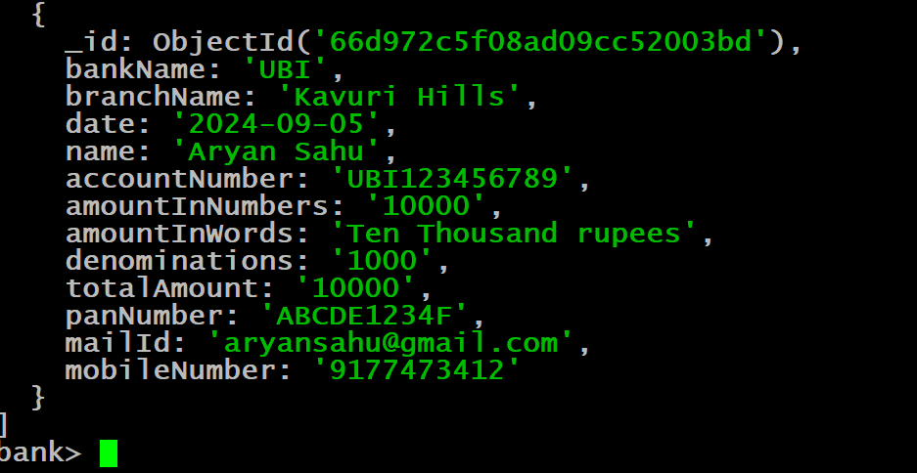
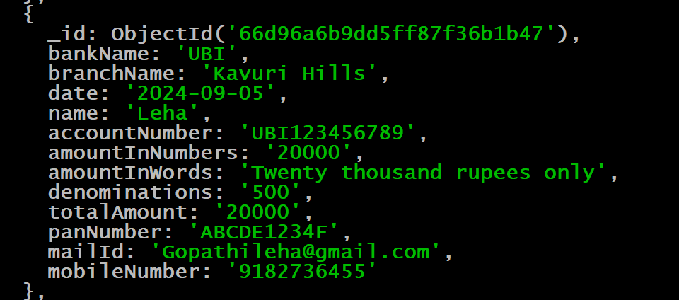
Data Retrieved
Publicis
Sapient

Slide 17
Thank You
Publicis
Sapient

